Slide 1
DOE-NNSA Massie Chair Program Activities at Tuskegee University
Nosa O. Egiebor
DOE/NNSA-Samuel P. Massie Chair
Chemical Engineering Department
Tuskegee University
Tuskegee, AL 36088

Slide 2
Current Massie Chair Team at Tuskegee University
Research Faculty:
Dr. Tarig Hassan – Research Asst. Professor
Students:
Freddie Eskridge - Undergrad
Timothy Powel - Undergrad
Valerie Gordon - Undergrad
Derrick Pattaway - Undergrad
Samuel Gana - Graduate (PhD)
Mishu Khan - Graduate (MS)
Faculty Collaborators:
Dr. Jonathan Mbah – Chemical Engineering
Dr. Shamim Begum – Chemical Engineering
Dr. Sesha Srinivasan – Physics

Slide 3
Massie Chair Program Activities at Tuskegee University
Research
Development of corrosion & degradation resistant materials (metallic alloys) for Generation IV nuclear reactors.
Education
Graduate students’ education and research training
Undergraduate education, and the integration of research into undergraduate training.
Outreach & Partnership
High school science teacher mentorship & Summer training for Grades 10 & 11 high school students
Summer internship for undergraduate students
National & international partnerships for STEM research & education
Africa-US Higher Education Initiative in STEM (USAID)

Slide 4
Research - Introduction
New DOE-NNSA Nuclear Energy Initiative ➔ Development of Generation IV Nuclear Energy Systems
These next generation nuclear plants (based on the Energy Policy Act of 2005), include:
Very High Temperature Reactor (VHTR).
Up to 950ºC output temperatures
Gas cooled (Helium, CO₂, etc.)
Sodium Fast Reactor (SFR).
500 – 550ºC
Liquid sodium cooled

Slide 5
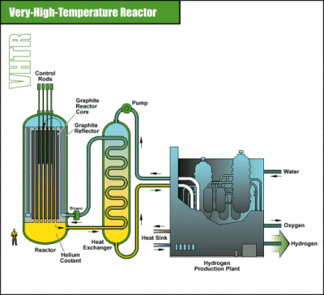
Schematics of VHTR Gen. IV Reactor

Slide 6
Introduction (contd.)
Advantages of the Generation IV Nuclear Reactors
Improved safety and reliability.
Sustainability & Cost effectiveness.
Significant proliferation resistance.
Hydrogen production through high temperature electrolysis of water.
Deep-Burn capability ➔ Significantly reduced high-level waste generation.
Implementation in 2011-2021 time frame.

Slide 7
Research Needs of Gen. IV Reactor Development
Critical R & D Needs:
Development and evaluation of materials for use in Generation IV nuclear reactors under high temperatures and pressure
Behavior of high-temperature gas reactor fuels
Design methods development & validation
Hydrogen production technologies
Energy conversion processes

Slide 8
Tuskegee Research Objectives
Study the effect of high service temperatures (500º – 1000ºC) on the nanostructure and phase transformation behaviors of predetermined compositions of ferritic steel, oxide dispersion strengthened steel (ODS), and nickel-based alloys as candidate materials for Generation IV reactor systems.
Investigate how alloy compositions affect surface corrosion behavior, particularly the initiation of stress corrosion cracking (SCC).
Evaluate the effect of elevated temperatures and pressures, and helium-coolant hydrodynamics on the corrosion behavior of ferritic steel, nickel steel, and ODS candidate steel samples.
Investigate the effect of aging and extended reaction times (6 – 24 months) under high temperatures on the corrosion response of Ferritic, ODS, and nickel-based alloy samples.

Slide 9
Our Previous Research Approach (Grant Period 2005-2010)
Obtain candidate metallic alloys of various compositions from commercial suppliers.
Subject the samples to severe service conditions of high temperatures & pressure.
Study the impact of severe conditions on micro-structural evolution such as Cr surface segregation.
Evaluate the corrosion resistance and physical stability of the treated samples using electrochemical impedance spectroscopy (EIS).
Problem ➔ We had difficulties finding suppliers for the needed compositions of the candidate alloys needed.

Slide 10
Current Research Approach
Produce the materials in our lab ➔ Produce Oxide Dispersion Strengthened (ODS) steel and Fe-Cr alloys by Mechanical Alloying (MA) from powders.
Hot press the powdered alloys to sheets for evaluation
Evaluate and characterize the alloys in terms of microstructure, physical and mechanical properties.
Determination of corrosion and degradation resistance at elevated temperatures & coolant hydrodynamics.

Slide 11
Mechanical Alloying (MA)➔ e.g. ODS Alloy Production
Step 1. Ball milling of pure powders of the constituents, e.g Fe, Ti, Al, & Yttria (Y₂O₃) to form oxide dispersion strengthened (ODS) alloy
Form sub-micron particles of alloys (nanomaterials)

Slide 12
Step 1. (Contd.) Ball Mill Operating Principles
Feed material: < 4 mm powders Final fineness*: < 1 µm, for colloidal grinding < 0.1 µm
1. Milling/grinding, 2. mechanical alloying, 3. nano-structure development, 4. reactive bonding

Slide 13
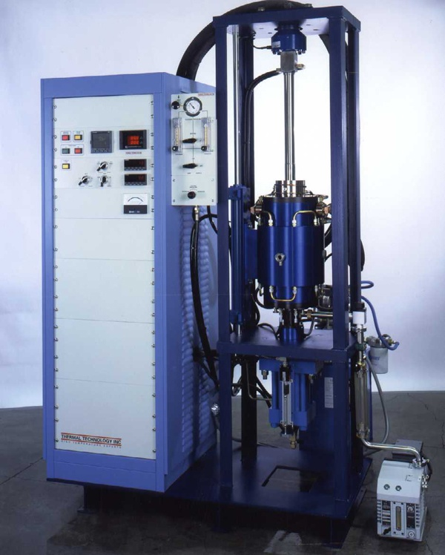
Step 2 (MA) ➔ High Temperature Press to Form Flat Alloy Sheets (45 tons)

Slide 14
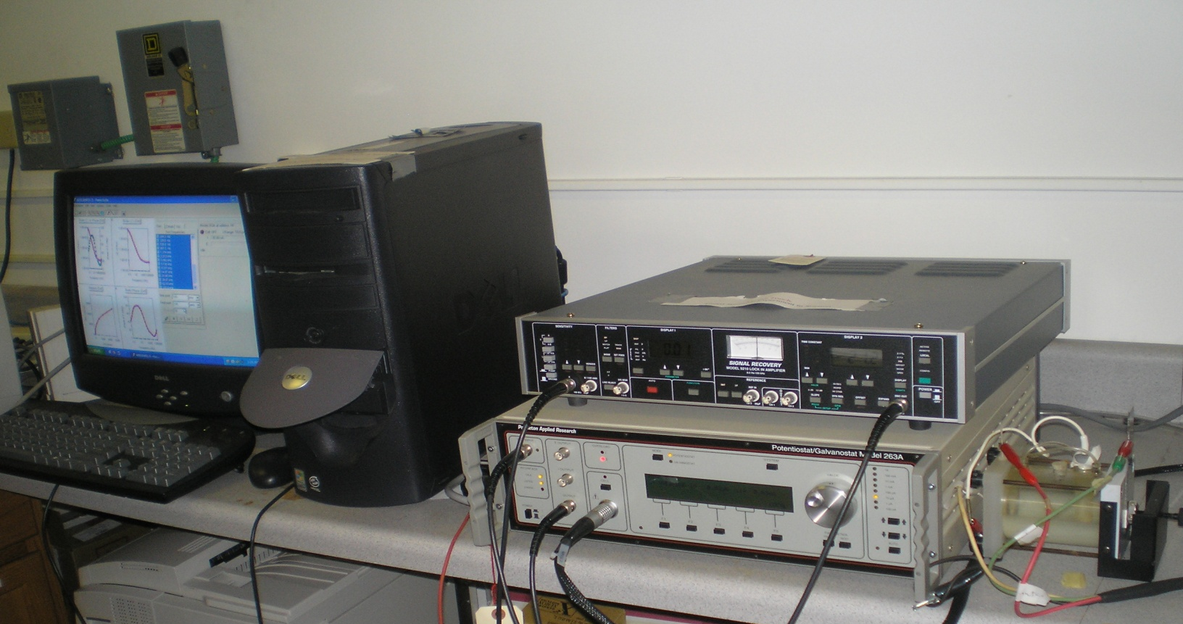
Step 3: Study of Corrosion Resistance & Physical Stability at High Temps
3-Electrode Potentiostat for Electrochemical Impedance Spectroscopy (EIS)

Slide 15
Outreach & New Partnership ➔ Africa-US Higher Education STEM Initiative
Tuskegee University – Massie Chair program partnering with:
International Institute for Water & Environmental Engineering (2iE) in Burkina Faso
University of Mines & Technology (UMaT) in Ghana
University of Benin, Benin City, Nigeria
USAID/Higher Education for Development (HED)
Awarded $1.1 million for 2010 – 2012 as initial implementation grant from USAID

Slide 16
Minority STEM Capacity Development Impact
Annual Impacts:
20 – 30 undergraduate students receive tutorship annually
5 – 8 undergraduate students are engaged each year for direct laboratory research training.
5 High school students are involved in summer training per year
3 MS & PhD graduate students per year
1 Postdoctoral Research Fellow
3 Junior faculty members are mentored

Slide 17
THANK YOU!!
QUESTIONS Please?

